Slide 1
The Application of Convolution to Suffix to Prefix Rule for the Exact
String Matching Problem
Zhong He Chen and R. C. T. Lee
The 24th Workshop on Combinatorial
Mathematics and Computation Theory, pp. 393- 399
Date: June 20, 2007
Introducer: Chung-Han Chiang

Slide 2
Abstract
In this paper, we consider the exact string matching problem. We first point out a rule, called the suffix to prefix rule, which can be used to avoid the brute-force sliding window approach. The Backward Nondeterministic Matching algorithm, Backward Oracle algorithm and Reverse Factor algorithm all use this rule. To implement this rule, we have to find the longest suffix of text T which is equal to a prefix of pattern P. In this paper, we point out that convolution can be used to do this. As can be seen, the convolution technique is easy to understand and easy to program.

Slide 3
Definition
Suffix: Given a string X = x₁x₂…x_{n}. S is called a suffix of X if S = x_{i}…x_{n} , for i ←{1 …n}.
For example, X=abc. We can see that “abc”, “bc” and “c” are all suffixes of X.
Prefix: Given a string X = x₁x₂…x_{n}. S is called a prefix of X if S = x ₁…x_{i} , for i ←{1.. n}.
For example, X=abc. We can see that “abc”, “ab” and “a” are all prefixes of X.

Slide 4
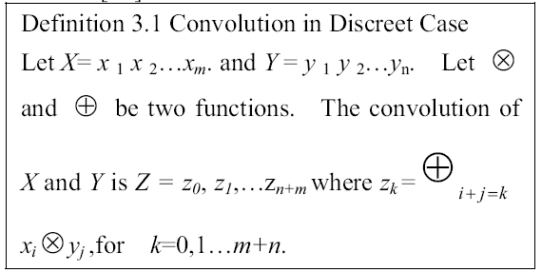
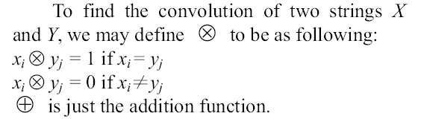
Convolution

Slide 5
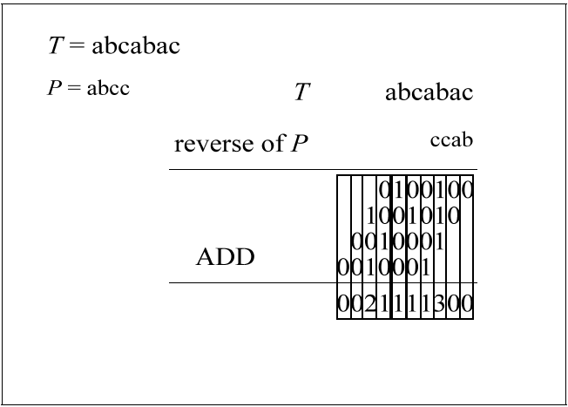


Slide 6




Slide 7
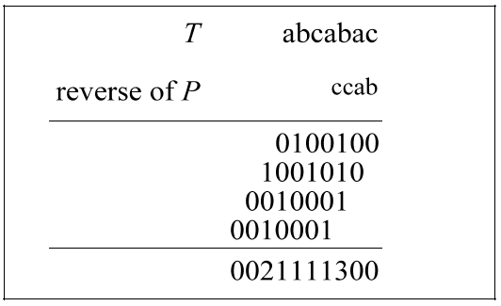
Using Convolution to Find the
Longest of Suffix U Which Is a Prefix of P
F-vector
If the i-th value counted from right to left of F-vector is exactly equal to i, we know that the suffix of text T of length i is also a prefix of pattern P.

Slide 8
Algorithm FindTheLongestSuffixU
Input: A string X = x ₁, x ₂, x₃…x_{m} and a string Y =y₁,y₂, y₃,…, y_{m}.
Output: The longest suffix U of X which is also a prefix of Y
Step 1. Do a convolution of X and Y and get F-vector.
Go to step 2.
Step 2. Set i=1 and denote the length of U be |U|.
Step 3. If i ≦ m, go to step 4. Otherwise, go to step5.
Step 4. If the i-th value counted from right to left of F-vector is exactly equal to i, Set |U | = i. Let i =i+1 and go to step3.
Step 5. Report U =x_{m-|U|+1}, x_{m-|U|+2}, x_{m-|U|+3},…x_{m-1}, x_{m}.

Slide 9
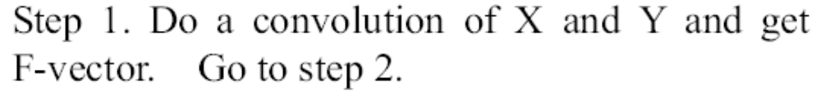
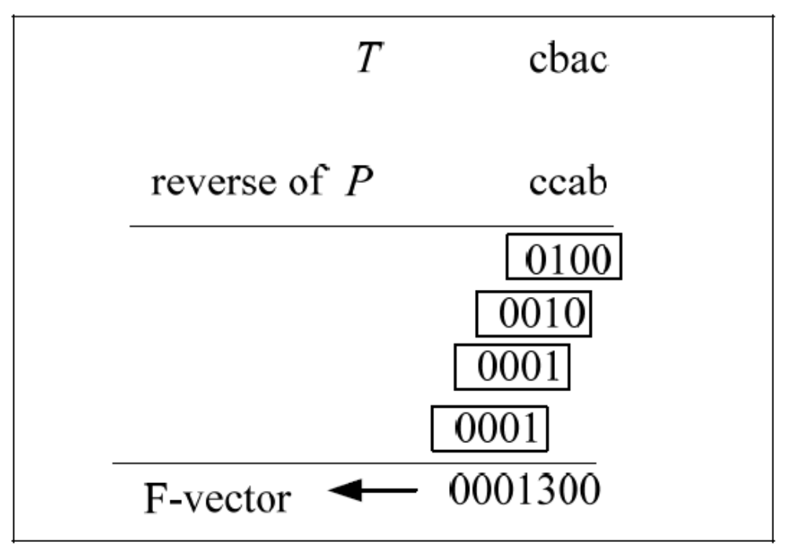

Slide 10


Slide 11
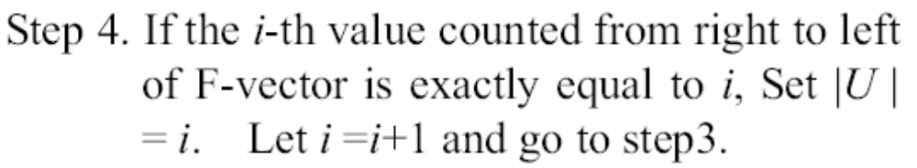
i | 7 | 6 | 5 | 4 | 3 | 2 | 1
U | 0 | 0 | 0 | 1 | 3 | 0 | 0

Slide 12
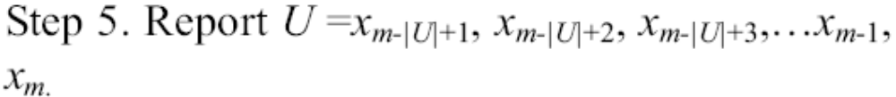
i | 7 | 6 | 5 | 4 | 3 | 2 | 1
U | 0 | 0 | 0 | 1 | 3 | 0 | 0
i = 3, U = 3
U = X₄₋₃₊₁, X₄₋₃₊₂, X₄₋₃₊₃ = X₂,X_{3,} X₄ = bac
(T= cbac, P = bacc)

Slide 13
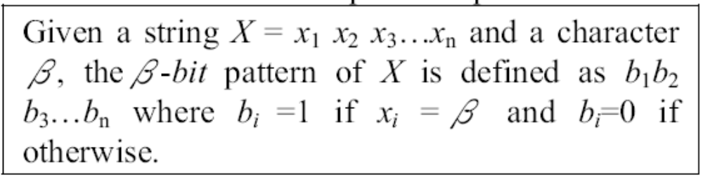
The Bit-Pattern Approach
For example, X = bacc.
a-bit pattern of X is 0100.
b-bit pattern of X is 1000.
c-bit pattern of X is 0011.

Slide 14
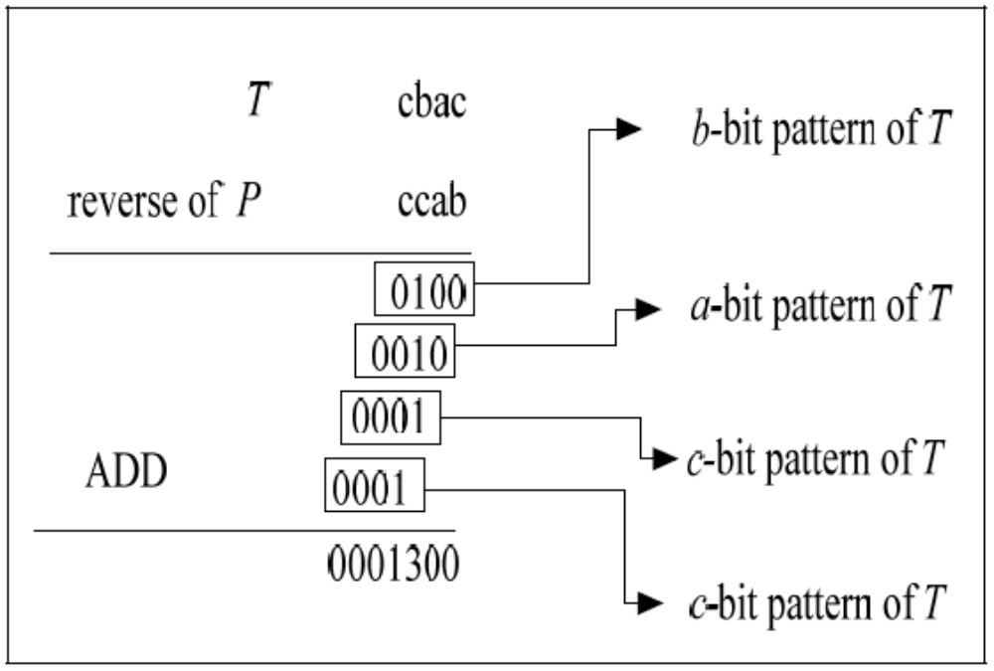

Slide 15
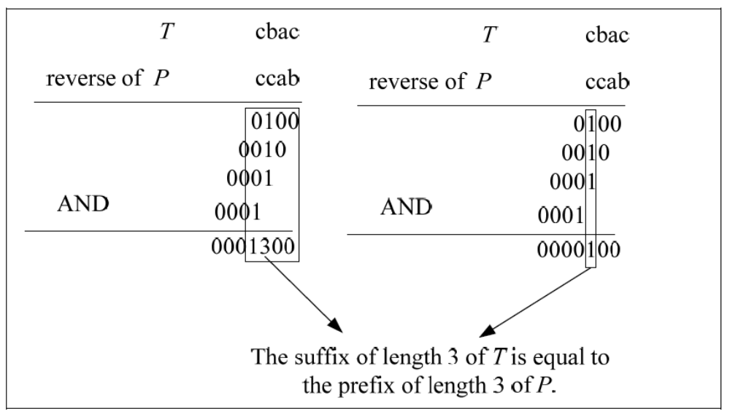

Slide 16
